Slide 1
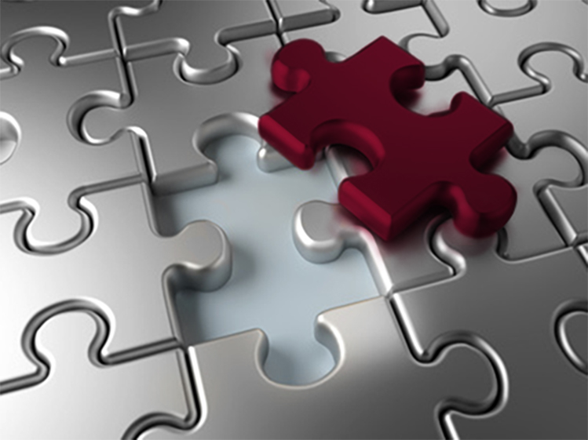
Completion Global
Innovation for the Great Commission
Don Allsman, CEO
Cathy Allsman, VP Prison Ministry Mobilization
www.completion.global
info@completion.global

Slide 2
A Kingdom Response to Our Ethnic Division
Skim many slides quickly to get to your interests
Approach
Ten Assumptions
Six Biblical Principles
Eight Common Questions (and Discussion)
What do we do? (last 10 minutes)

Slide 3
Exegetical Approach
Observation: What are the Biblical non-negotiables?
Situation: How do we sort through the complexities?
Application: What do we do as the people of God?

Slide 4
My 10 Assumptions
Current events are troubling but not new, nor unmanageable for Jesus and His unshakable Kingdom: Jesus is Lord.
The enemy is not other people (Eph. 6:10): This is Kingdom warfare.
This is an opportunity for our light to shine in the darkness, not a senseless tragedy.

Slide 5
My 10 Assumptions
There is room for disagreement: clarity over agreement.
I will refer to groups in various ways (POC, A-A, Black, White, Anglo, European descent).
We are not mono-lithic: No intention to stereotype label everyone (not all African-Americans are the same nor all Anglos the same).

Slide 6
My 10 Assumptions
The answer is not political but relational.
Be aware of grief: Dialogue is different in grief than it is afterward.
Everyone (on all sides) feels disenfranchised and threatened.
In America today, decisions are made based on tribalism more than on facts, making reconciliation difficult.

Slide 7
Stages of Grief in Abuse
Shock and denial: how can this still be happening?
Pain and guilt: maybe it’s partially my fault (maybe we are inferior, stupid, lazy, corrupt)
Anger and bargaining: harsh words, rioting, radical demands, vengeance, “I’m gonna get mine”
Depression: “I’m sick of tired of being sick and tired”
Upward turn: more calm and ready to talk reasonably
Reconstruction: begin putting the pieces back together
Acceptance and hope: gradual acceptance of a new future

Slide 8
Tribalism*
It used to be believed that if people had access to shared information, we would be more unified (i.e. facts change minds).
The desire to be a good member of the tribe is now more important than being correct (i.e. people choose to be wrong if it keeps them in good standing with peers).
People get more angry when their tribe (or leaders) are attacked than when their beliefs are attacked (groupthink).
Tribalism vilifies the opposition as “that group” rather than individuals (making it difficult for personal relationship).
*https://youarenotsosmart.com/transcripts/transcript-tribal-psychology

Slide 9
Six Biblical Principles
We are one “race” by virtue of Jesus’ blood.
But you are a chosen race, a royal priesthood, a holy nation, a people for his own possession, that you may proclaim the excellencies of him who called you out of darkness into his marvelous light.
- 1 Pe. 2:9

Slide 10
Six Biblical Principles
We retain our diversity (ta ethne) right into heaven.
Worthy are you to take the scroll and to open its seals, for you were slain, and by your blood you ransomed people for God from every tribe and language and people and nation…
- Rev. 5:9

Slide 11
Six Biblical Principles
Jews and Gentiles were hostile to each other but were brought together in Christ.
Remember that you were at that time separated from Christ, alienated from the commonwealth of Israel and strangers to the covenants of promise, having no hope and without God in the world. But now in Christ Jesus you who once were far off have been brought near by the blood of Christ. For he himself is our peace, who has made us both one and has broken down in his flesh the dividing wall of hostility.
-Eph. 2:12-14

Slide 12
Six Biblical Principles
When other members of the Body suffer, so do we. Rejoice with those who rejoice, weep with those who weep.
- Rom. 12: 15

Slide 13
Six Biblical Principles
We should respond in love, not fear.
Above all, keep loving one another earnestly, since love covers a multitude of sins.
1 Pe. 4:8

Slide 14
Six Biblical Principles
We can love more than one group at a time.
Honor everyone. Love the brotherhood. Fear God. Honor the emperor.
-1 Pe. 2:17

Slide 15
Situation: Sort Through Complexities

Slide 16
Eight Common Questions
Why the anger and self-destructive looting?
What is systemic or institutional racism?
What is White privilege?
Immigrants came with nothing, so why the complaining?

Slide 17
Eight Common Questions
What is the difference between race, culture, class, and ethnicity?
How do my political convictions play into this?
What about “Black Lives Matter” and “Critical Race Theory?”
What do we do to make matters worse?

Slide 18
Why the anger and self-destructive looting?
1. We process the same information differently
African Americans
Historically and collectively
Anglos
Situationally and individually

Slide 19
Anglos: Situationally and Individually
Analyze each event independently
What happened in today’s context (the past is gone)
Find ways to dismiss or disqualify person or circumstances
Denial of a pervasive problem

Slide 20
Historical/Collective
Each event part of historic experience over 400 yrs.
Each link in continuous, daily chain
What happens to him happens to me (us)
George Floyd ID

Slide 21
Field Dependent vs. Field Independent
Blacks and Hispanics
Anglos and Asians

Slide 22
We Interpret Events Differently
African Americans
Historically and collectively
Identification
Persistent
Desire for understanding
Want Anglos to acknowledge the situation first, then work together to fix it
400 years in the making, so won’t go away quickly
Anglos
Situationally and individually
Observation
Occasional
Desire to debate
Want to tell Blacks how to fix the problem with simplistic platitudes
Feel helpless to deal with the sins of the past
Desire a quick solution

Slide 23
Why the anger and self-destructive looting?
2. Persistent Humiliation/Danger
Humiliation/danger:
Inferior
Invisible
Frightening
to Anglos
Inferred: may be unintentional but hurts the same
Personal: overt expression by person or group
Legal: rule/policy

Slide 24
Why the anger and self-destructive looting?
3. Humiliation erased by good intentions
Humiliation and danger = “we” feel (legal, personal, inferred)
“Racism”: only if “I” intended it

Slide 25
Why the anger and self-destructive looting?
Denial of humiliation by white people (or silence or excuses)
400 yrs. of daily humiliation by white people
Maybe this time
they’ll get it

Slide 26
Cycle of Frustration
Denial by white people (or silence or excuses)
Daily humiliation by white people
Public display of injustice
Maybe this time
they’ll get it

Slide 27
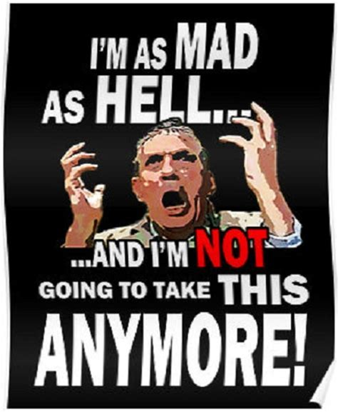
Cycle of Frustration
Denial by white people (or silence or excuses)
Daily humiliation by white people
Maybe this time
they’ll get it

Slide 28
“We’ve tried to be nice. We’ve tried to forgive. We’ve tried to be patient. But if this is what it takes to get their attention, let it burn.” – Killing of George Floyd, 2020

Slide 29
Until White people break cycle of denial:
Cycle of frustration will continue OR
Black people will learn to accept inferiority; give up hope

Slide 31
What is Systemic Racism?: 2 Meanings
Rule/policy: Blacks inferior, invisible, safe to White people
Slavery in the Constitution 1619-1865
Jim Crow laws 1865-1965
Baseball color barrier 1947
Missions organizations 1920
Separate but equal education 1954
Red-lining 1968
Seminary placement policy 2006
Differing laws over drug use 2010
Police profiling 2021

Slide 32
“Systemic Racism” as Collective Whole
Inferred
Racism
Personal
Racism
Policy
Racism

Slide 34
What Is White Privilege?
Advantages Whites have over PoC
American privilege, male privilege, tall privilege
Generations of racism (all three) leaves Whites with imbalance of opportunity: education, generational wealth, workforce
Slavery, Jim Crow, GI Bill, redlining
My life: grandparents, parents
Simple fact: doesn’t have to be controversial

Slide 35
What Is White Privilege?
(2 Uses: Description, Weapon)
Advantages Whites have over PoC
American privilege, male privilege (CSA patio), tall privilege
Aamco story 1985
Generations humiliation (3 dimensions): imbalance of opportunity: education, generational wealth, public safety
Workforce: 85% jobs through networking
Slavery, Jim Crow, GI Bill, redlining, VHA
My life: grandparents, parents: equity, college, networks
Simple fact: doesn’t have to be controversial

Slide 36
What Is White Privilege?
2. Weapon to create shame, defense
Create imbalance, vulnerable, discredit
Silence discussion
“You didn’t earn it”
“You owe us so give me whatever I demand”
Black version of “You didn’t earn it b/c quota”
I prefer to translate: “White advantage”

Slide 37
What Is White Privilege?
Anglos who profit from White advantage, Blacks who profit from White guilt
Neither one promotes reconciliation and healing (Jack Brewer: shame won’t move us to understanding)
Response: “Of course there is White privilege, but what do you suggest we do together about it?”

Slide 38
Various Implications of White Privilege
Give us dignity and equal opportunity (follow the documents)
Replace White supremacy with Black supremacy
Let us keep our culture but work together for Christ (Kingdom)
There is no White privilege (we’re Americans)
Meet our requests (pie-splitting)
Yes, as Americans
No, as Christians
Yes, as Christians
No, as humans
Let’s talk

Slide 39
Let’s Talk
Policing reform
National anthem
More corporate board memberships
More leadership representation
Reparations
Removing monuments
Economic policy
Expression of protest
Affirmative action
Government funding
Join our “tribe”
Changing names of buildings, mascots
Legislation
Deconstructing history
More discussion (politics)

Slide 41
Immigrants came with nothing, so why the complaining?
Immigrants
Came by choice
Have to earn respect
Start at ground zero
With hard work, I can make it
Admittance to institutions
Strong family structure, pooled resources
Like orphans
African Americans
Kidnapped, abused, rejected
Generational disrespect
Started below zero
Even with hard work, we’ll never make it
Forced to create separate institutions
Stripped of family (Africa and U.S.)
Like rejected foster children

Slide 43
Differences between race, culture, class, and ethnicity?
Ethnicity: differences in human genetics (Asian, African, European)
Race (2 uses: generic/specific)
Generic: same as ethnicity
Specific: one human race or species (social Darwinism/Nazism)
Culture: human preference (food, clothes, beauty, language)
Class: socio-economic status (U.S.: wealth, education, occupation)

Slide 44
Race, Culture, Class, and Ethnicity in the Kingdom
Race: one blood, humans created in the image of God
Ethnicity: diversity valued by God into eternity
Culture: preferences vs. ethnocentrism (mine are best)
Good (work ethic)
Evil (greed/idolatry)
Neutral (food, clothing, music, language)
Class: tempted to superiority (look down on others)

Slide 45
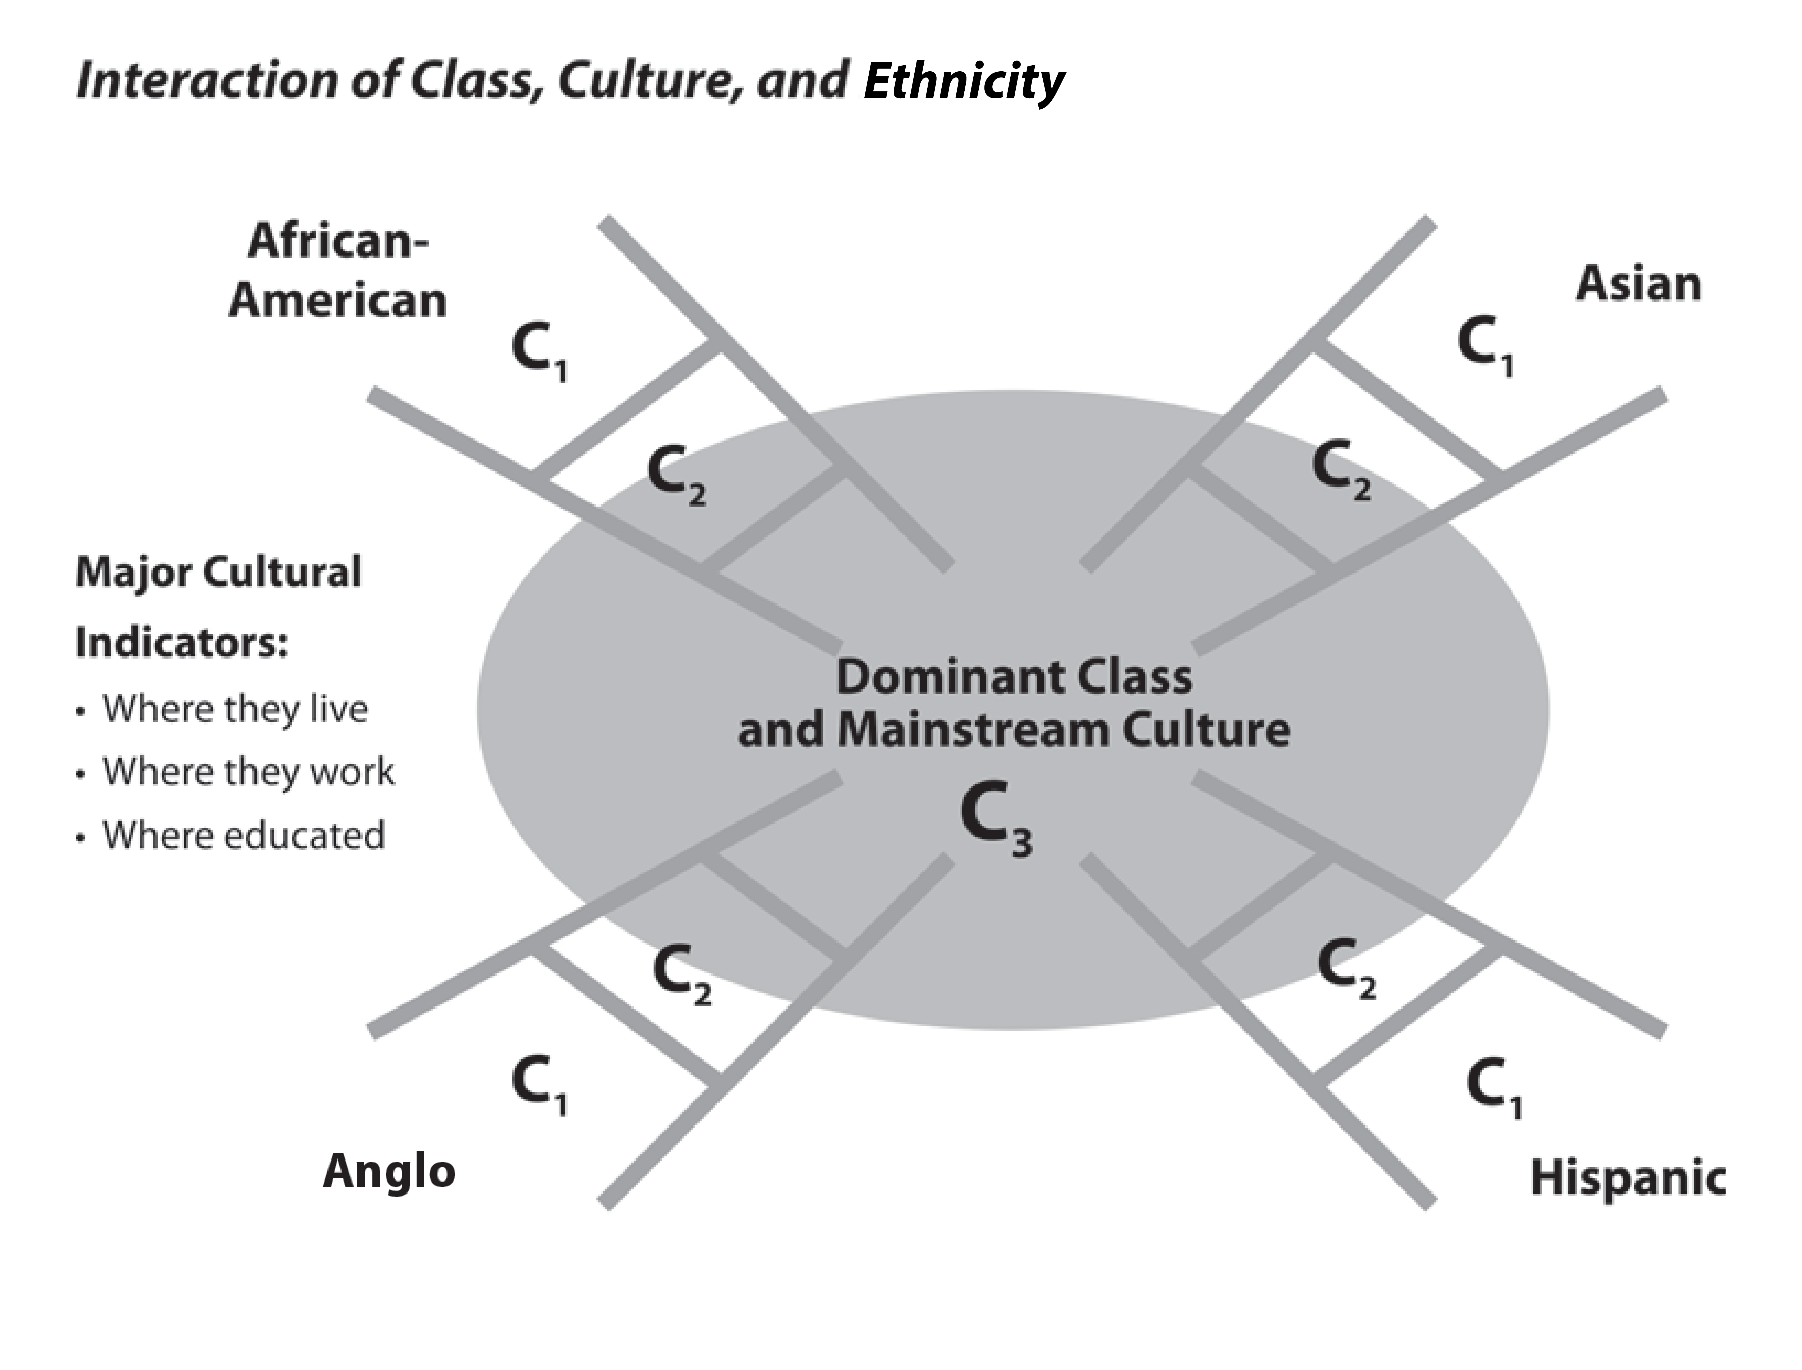
How we view white advantage, ethnic injustice and the solutions depends on class, culture, ethnicity, not just ethnicity.

Slide 46
Sub Culture Implications
We are not monolithic
Black/White reaction to racism depends on C₁₋₂₋₃
Black requests of Whites depends on sub-culture
White response to Black actions depends on sub-culture
Latino and Asian reactions are different based on C₁₋₂₋₃

Slide 48
How do my political convictions play into this?
In democracy, Christians should use politics as an expression of loving God and neighbor (not exercise power/Lord it over another)
How we love expressed different ways (no R_{x})
We express differently (culture, class, ethnicity)
No surprise we have conflict in the Body in U.S.

Slide 49
The Assumptions
Conservatives (esp. White):
Values 1st, ethnicity 2nd;
My side (individual)
Battle=keep/regain the good life
Blacks (esp. Democrats):
Ethnicity 1st, values 2nd
Our side (aggregate)
Struggle=get the good life

Slide 50
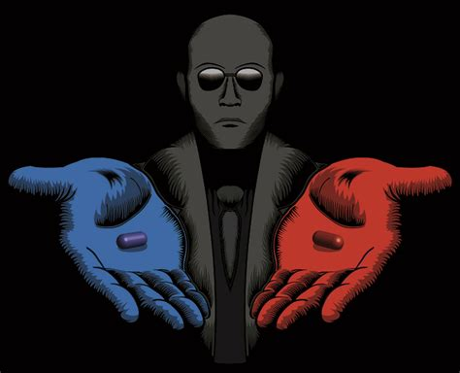
Plagued by a False Dichotomy

Slide 51
Plagued by a False Dichotomy
NT Wright: “People in fear grasp at package deals. They can’t open the package and separate the contents one by one.”

Slide 52
What Conservatives See
Defund police
Pro-abortion
Anarchy
Disrespect flag
Sexual confusion
Socialism
Cultural oppression
Revise history
Destroy America
Evil SCOTUS
Support police
Pro-life
Civil order
Respect flag
Sexual purity
Equal opportunity
Cultural freedom
Honor history
Rescue America
Good SCOTUS

Slide 53
What Conservatives See
Defund police
Pro-abortion
Anarchy
Disrespect flag
Sexual confusion
Socialism
Cultural oppression
Revise history
Destroy America
Evil SCOTUS
Support police
Pro-life
Civil order
Respect flag
Sexual purity
Equal opportunity
Cultural freedom
Honor history
Rescue America
Good SCOTUS
To agree that Black people still suffer injustice and humiliation, I have to take the Blue pill, which will:
Associate with the enemies of our society
Violate conscience, disloyal to Jesus
Ostracize me from my tribe

Slide 54
What Black Democrats See
Police equal protection
Pro-life womb-tomb
Looting wrong; so is targeting us
Love America, not perfect
Sexual clarity with ethnic dignity
Equal opportunity (stop gaming sys)
OK to be Black
Reframe history, not revise
Make American Great for once
SCOTUS for all
Police:keep us in place
Pro-life hypocrisy
Law/order=White supremacy
Flag=white supremacy
Sexual purity>human dignity
System doing it to us
White culture to assimilate into
Holding history=white supremacy
MAGA=MAWA
SCOTUS for Whites

Slide 55
What Black People See
Police equal protection
Pro-life womb-tomb
Looting wrong; so is targeting us
Love America, not perfect
Sexual clarity with ethnic dignity
Equal opportunity (stop gaming sys)
OK to be Black
Reframe history, not revise
Make American Great for once
SCOTUS for all
Police:keep in place
Pro-life hypocrisy
Law/order=White supremacy
Flag=white supremacy
Sexual purity>human dignity
System doing it to us
White culture to assimilate into
Holding history=white supremacy
MAGA=MAWA
SCOTUS for Whites
To be a Republican, I have to take the Red pill, which will:
Associate me with the group causing our humiliation
Violate conscience, disloyal to Jesus
Ostracize me from my tribe

Slide 56
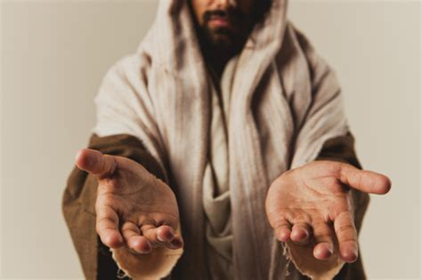
Another Option: Open Package
Love Police and Blacks
Pro-life womb-tomb
Civil order for all
Flag secondary to KOG
Sexual purity and human life
Equal econ opportunity
God values ethnic diversity
Accurate history
KOG>USA
SCOTUS for all
In the Kingdom, I don’t have to take either pill:
Associate with Jesus and His Word
Understand siblings have different experiences, ways to express love
Choose as best we can in a fallen world
Collaborate without compromise (this far only)
Calmly trust the future to God

Slide 57
The Goal
Conservatives (esp. White): As I put Kingdom first, I understand why a Black Christian would vote Democrat and still be on my side.
African Americans (esp. Democrats): As I put Kingdom first, I understand why a White Christian could be a Republican and still be on our side.

Slide 59
BLM and CRT: is it ok for me to endorse them?
False dichotomies: open the package and separate the contents one by one
We can love more than one thing
Test everything, hold fast to the good (1 Th. 4:21)
Understand the difference in BLM and blm

Slide 61
What do we do to make matters worse?
Minimizing pain: “That was a long time ago” or “at least we’ve made a lot of progress” or “you should be glad to live in America”
Creating distance: “I’m not racist” or “there is no White privilege”
US values > KOG values: “I don’t see color” or “we’re all Americans”
Insensitive to power differentials (locations, agendas)

Slide 62
Caucasian Damaging Actions
Making it about me and my pain
Telling Blacks how to feel or what to do
Asking Blacks to speak for all Blacks
Checking this off your list to ease your conscience
Taking on 400 years of humiliation and oppression

Slide 63
Caucasian Helpful Actions
Listen with humility, be slow to anger, until you can say, “I get it!”
Learn to lament the pain of others even if you don’t feel it personally
Find a LT friend, build trust; don’t check off list
Use White advantage to do all the good you can
Look for opportunities, then speak truth in love
Find ways to serve together on equal footing
Don’t look to Blacks for absolution, but God

Slide 64
African American Damaging Actions
Equating Republicans/Conservatives with White Supremacy
Lack of personal forgiveness
Assuming White people have more power than they do to change their peers
Assuming White people consciously use their ethnicity for personal gain
Using words as a weapon, e.g. White privilege, White supremacy
Assuming “advocates” have your best interest

Slide 65
African American Helpful Actions
Be patient (Gal. 6:9)
Leave vengeance to God
Don’t fall into entitlement, take all opportunities
Discourage victimhood, promote self-determination
Appreciate help from Republicans working within
Reciprocate awkward attempts at friendship
Speak the truth in love
Don’t look to Whites for dignity, but God
Serve together with White people on equal footing

Slide 67
Application: What Do We Do?

Slide 68
PEP-C
A four-step roadmap to ethnic reconciliation in America
Prioritization-Education-Personalization
COLLABORATION

Slide 69
PEP-C
Commitment to Christ and His Kingdom as foundational to reconciliation, with the Church taking the lead
Eph. 2, Jn. 15, Rev. 5, 1 Jn 3:8
Prioritization (Christ and Kingdom)

Slide 70
PEP-C
Reading, videos, panels to understand history and new paradigms of processing info
Education (Shared History)
Prioritization (Christ and Kingdom)

Slide 71
PEP-C
Relationship with another person who has a different life experience to listen, learn, lament together
Personalization (Trusted Friendship)
Education (Shared History)
Prioritization (Christ and Kingdom)

Slide 72
Both Are Ignorant Due to Lack of Friends
Blacks: White friends to listen
Dismissed, corrected by Whites
Embarrassing to share experiences
Afraid to lose friends so clam up
Fundamental distrust (when chips are down, “this close” to n-word)
Try to become White (distance)
Hard to explain experience
Worn out talking (wish Whites would explain it to other whites)
Silence misinterpreted as desire to retain supremacy
Whites: Black friends to explain
Fear of saying the wrong thing
Fear of being labeled a racist
Fear of being forced to admit to things we don’t really feel guilty about
Fear of friendship getting mired in race (“not that again”)
Don’t want to be seen as unpatriotic, leftist, or morally superior by other Anglos (Tribalism)

Slide 73
Friendship: Learn Respectful Dialogue
Eph. 4:29-30: “Let no corrupting talk come out of your mouths, but only such as is good for building up, as fits the occasion, that it may give grace to those who hear. 30 And do not grieve the Holy Spirit of God, by whom you were sealed for the day of redemption.”
We are not good at this
When we fail it grieves the Holy Spirit
We need to get better

Slide 74
Learn Respectful Dialogue
1 Timothy 1, 4, 6; James 3:13-18
Friction
Arguments
Myths
Controversies
Chaos
Swerving
Entitlement
Speculations
Ambition
Jealousy
Wandering
Frantic
Rights Conspiracies
Hatred
Conflict
Confident assertions
Pride
Vain discussions
Without understanding
Agitation
What fruit will come from this passion for justice and righteousness?

Slide 75
Learn Respectful Dialogue
1 Timothy 1, 4, 6; James 3:13-18
Confidence in Jesus
Love
Kingdom of God
Pure heart
Sincere faith
Stewarding deposit
Wisdom
Humility
Peaceable
Gentle
Open to reason
Merciful
Impartial
Sincere
Good conscience
Tranquility
What fruit will come from this passion for justice and righteousness?

Slide 76
PEP-C
Payoff: Kingdom, transcendant activity on equal footing displaying unity as a by-product rather than goal
Jn 17:23, Acts 17:27
COLLABORATION (Common Task)
Personalization (Trusted Friendship)
Education (Shared History)
Prioritization (Christ and Kingdom)

Slide 77
PEP-C
COLLABORATION (Common Task)
Find a church of another ethnicity to partner with
Periodic joint worship services
Formulate joint ventures
Plan joint retreat with two congregations

Slide 78
PEP-C
COLLABORATION (Common Task)
Black/White team volunteer in public school
Host quarterly/annual outreach events together
Go on mission trips together
Start a prison ministry together
Work together to reach third culture (diaspora)
Start a Reconciliation Fellowship-type group

Slide 79
PEP-C
COLLABORATION (Common Task)
Personalization (Trusted Friendship)
Education (Shared History)
Prioritization (Christ and Kingdom)

Slide 81
The Bottom Line
Respond in love not fear (opportunity for Gospel)
Find a trusted person
Listen, learn, lament
Do stuff together

Slide 82
