Slide 1
Completion Global
Innovation for the Great Commission
Don Allsman, CEO
Cathy Allsman, VP Prison Ministry Mobilization

Slide 2
Raise the Bar: Mobilizing the Incarcerated
for the Great Commission

Slide 3
The Bottom Line: As a Crossroads mentor, you have the privilege of investing in the future leaders of God’s Kingdom work to complete Jesus’ Great Commission. But to do so you will need to raise the bar when it comes to your expectations of the incarcerated.

Slide 4
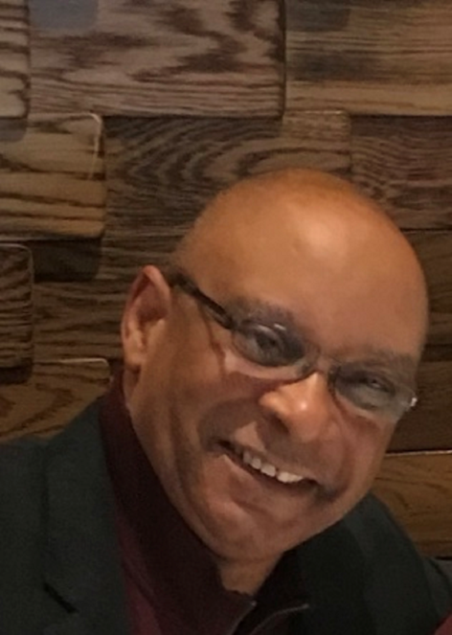
Our History
“There are two unmistakable manifestations of God’s Kingdom in America today: the revival breaking out in our prisons and that God is sending the nations of the world to our cities.”
-Rickie Bradshaw

Slide 5
Our History
1987-2018 World Impact empowering urban poor
Watched God slowly send the people groups of the world to US cities
Mission field coming to us: “diaspora” (dispersed)

Slide 6
Our History
2007-2018 training prisoners for ministry (7-70 locations in 12 states)
Potential deacons, elders, teachers, missionaries
Fruit falling to the ground
Motivated to mobilize prisoners
Met Douglas and Crossroads

Slide 7
Our History
2018 Completion Global:
Innovation for the Great Commission
Re-orient the Church to diaspora opportunity
Empower prisoners to join the mission force
Crowdsource missions by finding a place for everyone to serve without leaving their city

Slide 8
Jesus desires that every tribe, language, and nation is represented in his family
“And this gospel of the kingdom will be proclaimed throughout the whole world as a testimony to all nations [ethne/people group-PG], and then the end will come.”
- Mt. 24:14

Slide 9
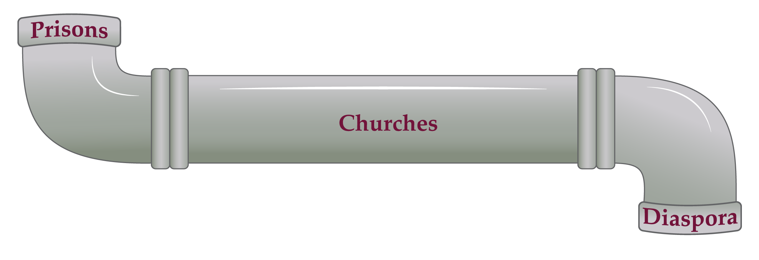
Prison to PG Pipeline
Prisons in 50 States
Trained for ministry
Cross-cultural evangelists
Fearless, passionate
Available for disciple-making, church planting upon release

Slide 10
Churches
Recidivism: character, job, housing
Prison culture; civilian culture
Inability to shift to civilian culture
Onesimus Workshop for churches
Climbing Up for prisoners

Slide 11
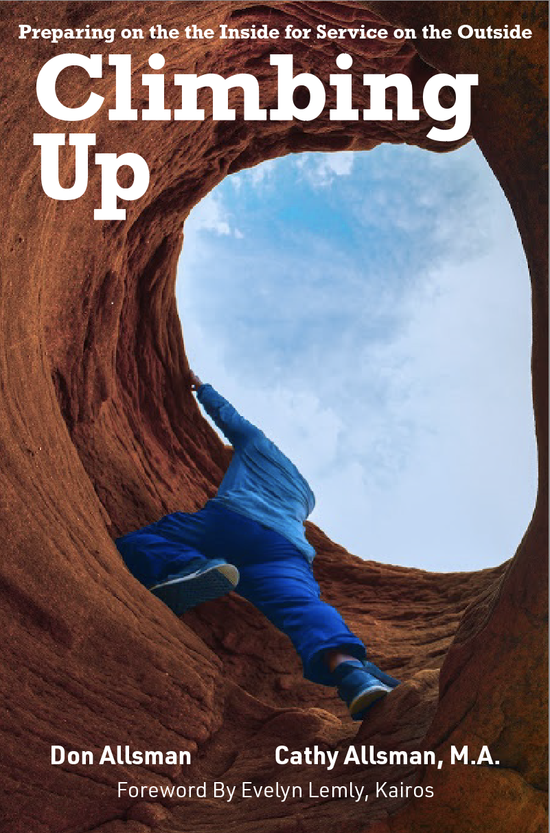
https://www.amazon.com/s?k=Onesimus+Workshop&ref=nb_sb_noss_2
https://www.amazon.com/dp/1735484806?ref_=pe_3052080_397514860

Slide 12
Diaspora Service Opportunities
Missions agencies, denominations, parachurches
Prison as recruiting location

Slide 13
In-prison mentoring (you)
Service opportunities (ministries)
Re-enculturation (church)

Slide 14
The Key
Your expectations of the person you are mentoring
What can they be for the Kingdom?

Slide 15
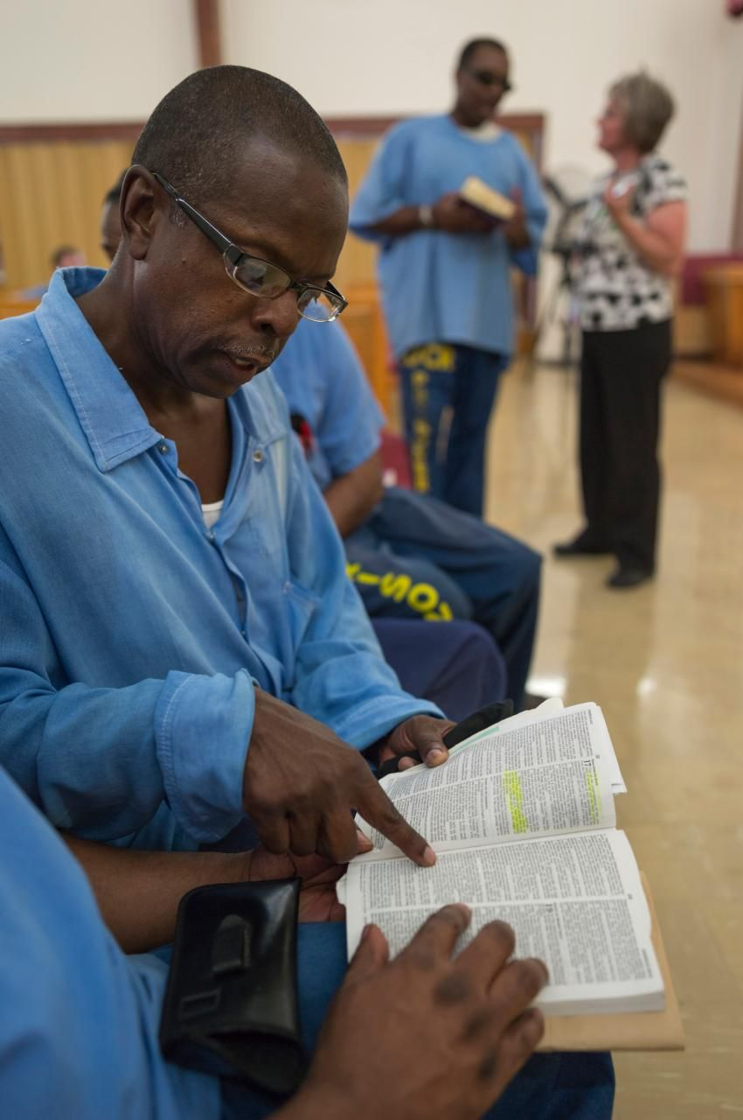
Raise the Bar of Expectations
Avoid returning to prison
Or
Effective servant for Christ and His Church

Slide 16
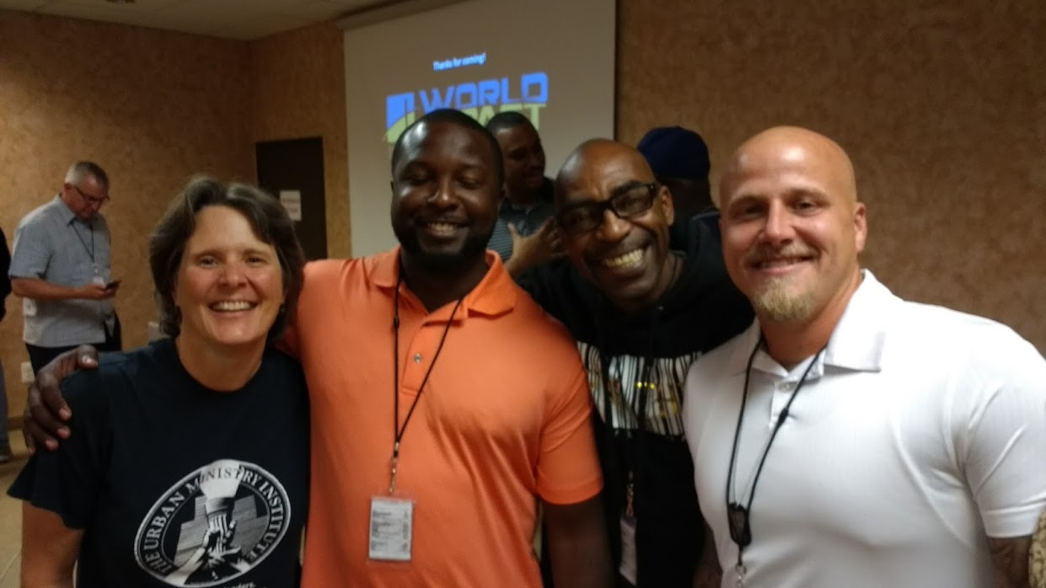
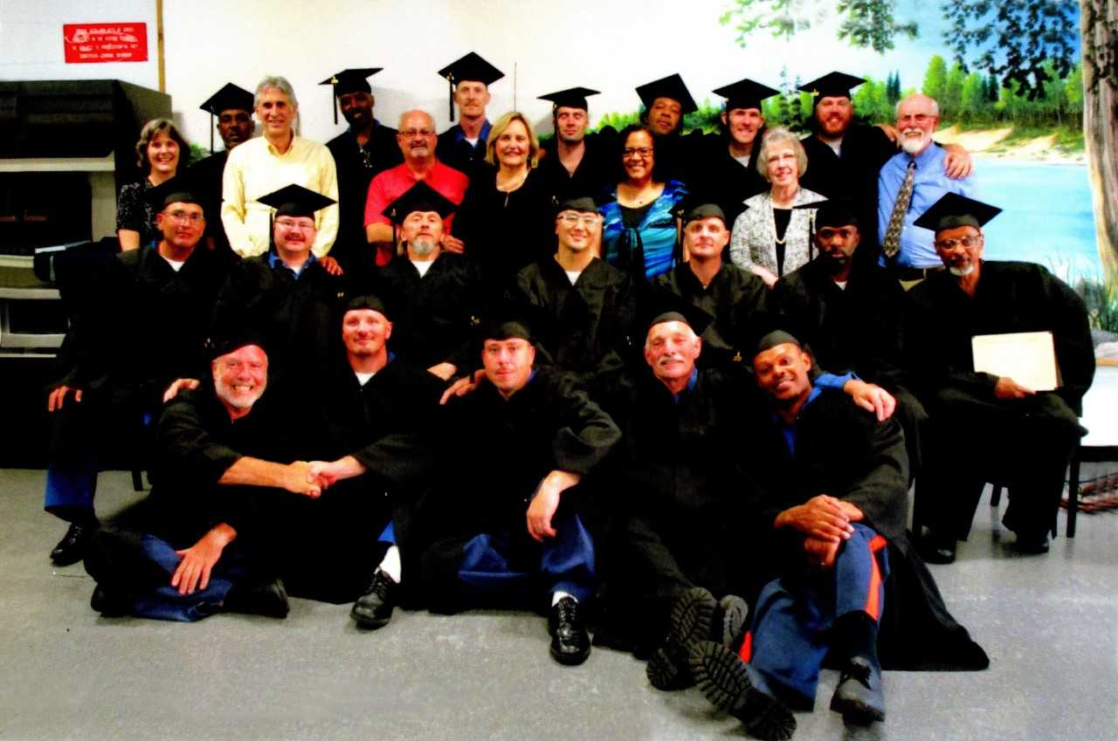
Raise the Bar of Expectations
Tools are there
Opportunity is great
Up to you: will you raise the bar of expectations?

Slide 17
Cathy Allsman, VP Prison Ministry Mobilization
www.completion.global
cathy.allsman@completion.global

