Slide 2
DFW Diaspora Coalition Agenda
Brief introductions
Mission, vision, values
Process of building coalition
Website development
People group tracker
Next steps

Slide 3
Introductions: name, ministry, where you live

Slide 4
Completion Global
Innovation for the Great Commission
Two passions: ta ethne and everyone involved
Inspire Church to world missions (diaspora)
Empower the under-represented (field to force)
Create crowdsourcing tools (full participation)
Don Allsman, CEO (don.allsman@completion.global)
Cathy Allsman, VP Prison Ministry Mobilization (cathy.allsman@completion.global)
www.completion.global

Slide 5
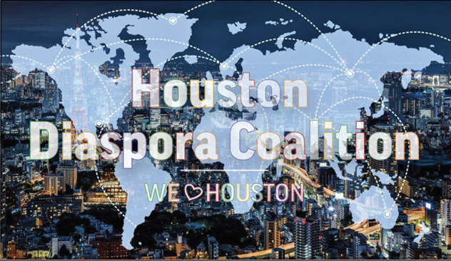
Completion Global
Innovation for the Great Commission
houstondiasporacoalition.net

Slide 6
Great Commission Without Leaving DFW
UPG* America (Diaspora)
Professionals
Immigrants
Refugees
Students
Videostreaming, cell phone discipleship and church planting
Friends/family (oikos)
Asia
Africa
Latin America
Europe
Visit near-culture uupgs*
*UPG unreached people group with so few Christian leaders they still need missionary support
*UUPG unengaged-unreached people group having no known full-time workers attempting discipleship or church planting

Slide 7
DFW Diaspora Coalition
Problems
Lack of bandwidth to collaborate
Lack of visibility: overlap/gaps in engagement
Willing workers unaware of opportunities
Lack of accessible technology tools
Complexity of urban setting

Slide 8
Solution: Ecosystem
Organisms interact to form life
No central leadership
Each does its part for the whole
Sharing the load: reduce a full plate

Slide 9
DFW Diaspora Coalition
Solution
Metro-wide collaboration (church, parachurch, agency)
Retention of organizational identity
Minimum commitments (time/money)
Onramp for lay volunteer opportunities
Accessible technology tools

Slide 10
DFW Diaspora Coalition
Mission
Convene a local, organic network of people offering holistic ministry, evangelism, discipleship, church planting, and church leadership development for DFW’s diaspora people groups until such time that there are no remaining unengaged-unreached people groups on the earth.

Slide 11
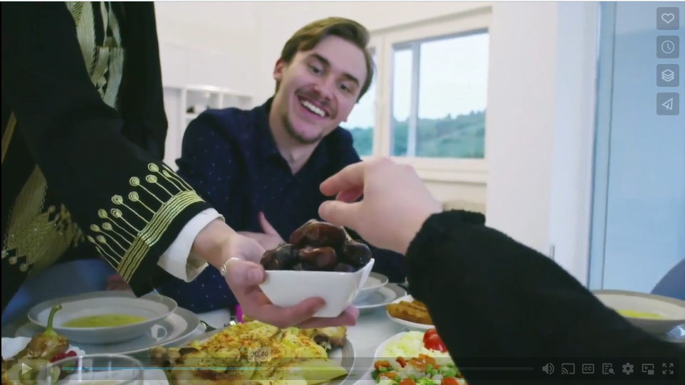
https://vimeo.com/840118669?share=copy

Slide 12
DFW Diaspora Coalition
Initial Vision
Develop a city-wide strategy to establish indigenously-led churches among every UPG in DFW until each one plants a church among its homeland people.

Slide 13
DFW Diaspora Coalition
Phases
Develop ecosystem and invite others as peers
UPGs reproduce in the homeland
Move to indigeneity (diaspora take ownership)
Completion Global helps development, hand off

Slide 14
DFW Diaspora Coalition
Values
Build on local history
Every-believer participation
Deference to culture
Reaching the world
Honoring member distinctives

Slide 15
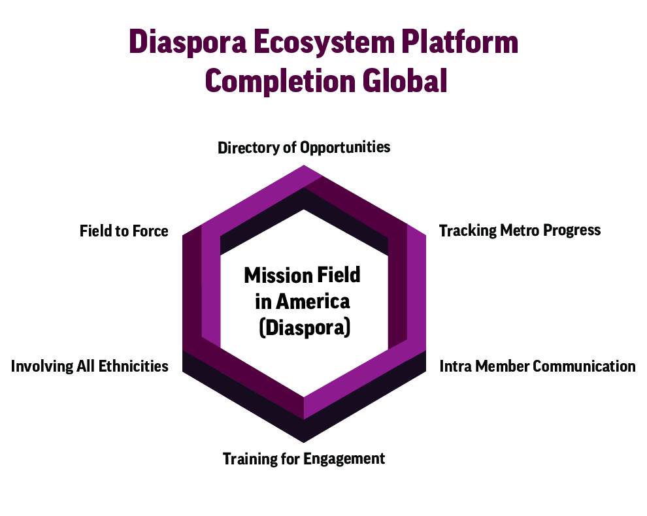
DFW Diaspora Coalition Ecosystem

Slide 16
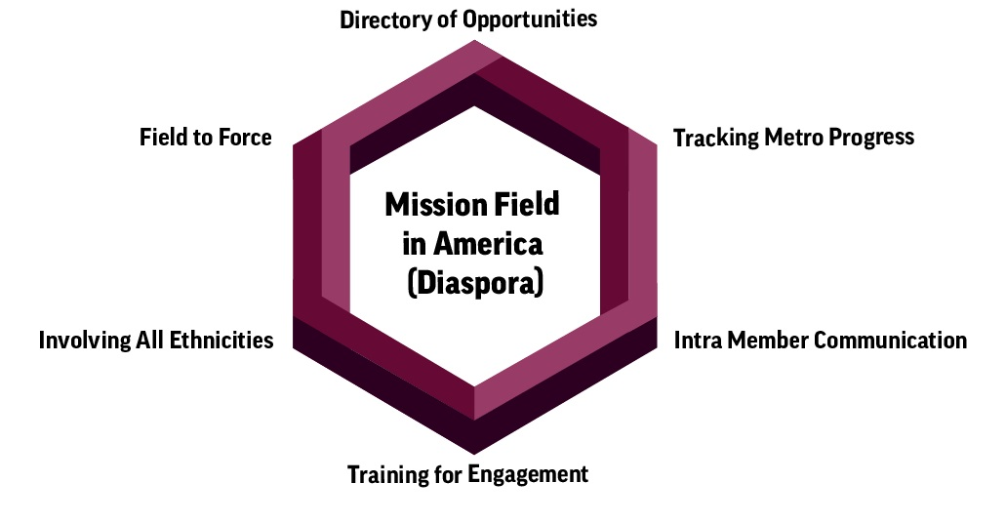
Ecosystem Design
Directory of opportunities

Slide 18
Options for Involvement
SUPPORTING DIASPORA WORKERS
Administrative Support
Strategic Prayer
Research
Media or Technical Support
Training Prisoners for Diaspora Ministry
EXPLORING DIASPORA MISSION
Learning about World Missions
Understanding Islam
Understanding Buddhism and Hinduism
Understanding Tribal Religions
Befriending co-workers
STRENGTHENING DIASPORA CHURCHES
Sharing property and resources
Collaborating to reach your community
Scripture and Related Resources
Bible and Leadership Training
ENGAGING DIASPORA NEIGHBORS
Discipleship or Church Planting
English as a Second Language
International Student Ministry
Refugee Ministry
Advocacy and Whole-person Wellness

Slide 20
Ecosystem Design
Directory of opportunities
Tracking metro progress

Slide 21
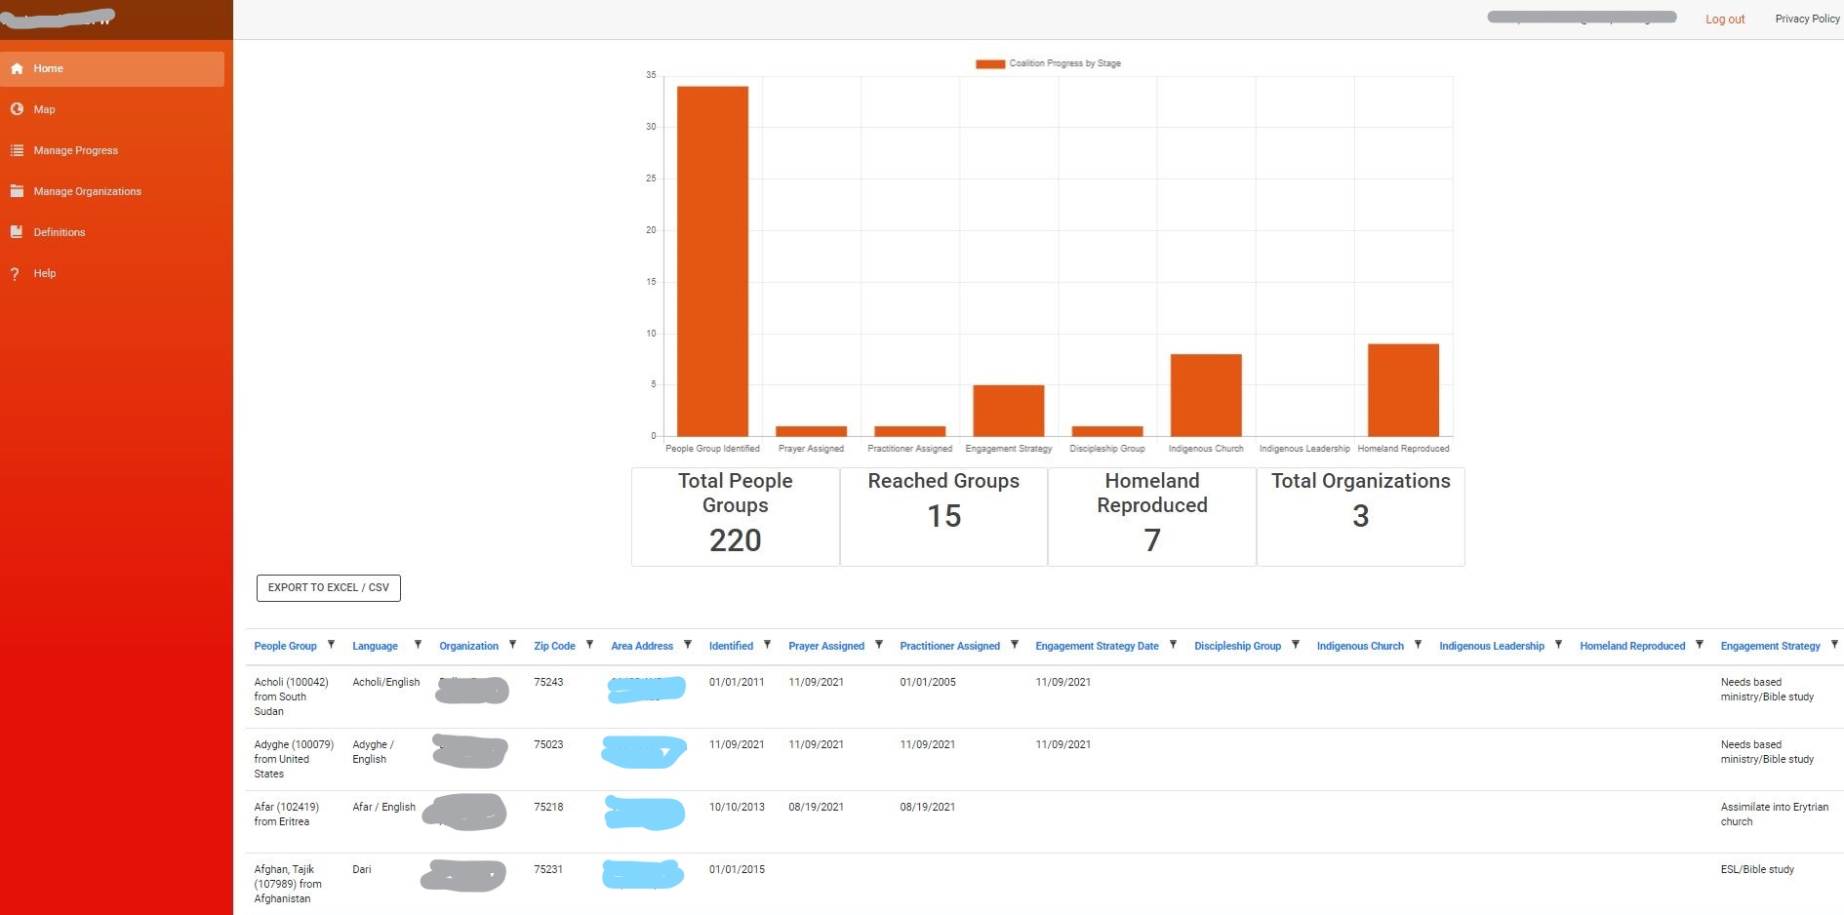
People Group Tracker

Slide 22
Milestones
PG Identified
Prayer assigned
Practitioner assigned
Engagement strategy
Discipleship group
Indigenous church
Indigenous leadership
Homeland reproduced

Slide 23
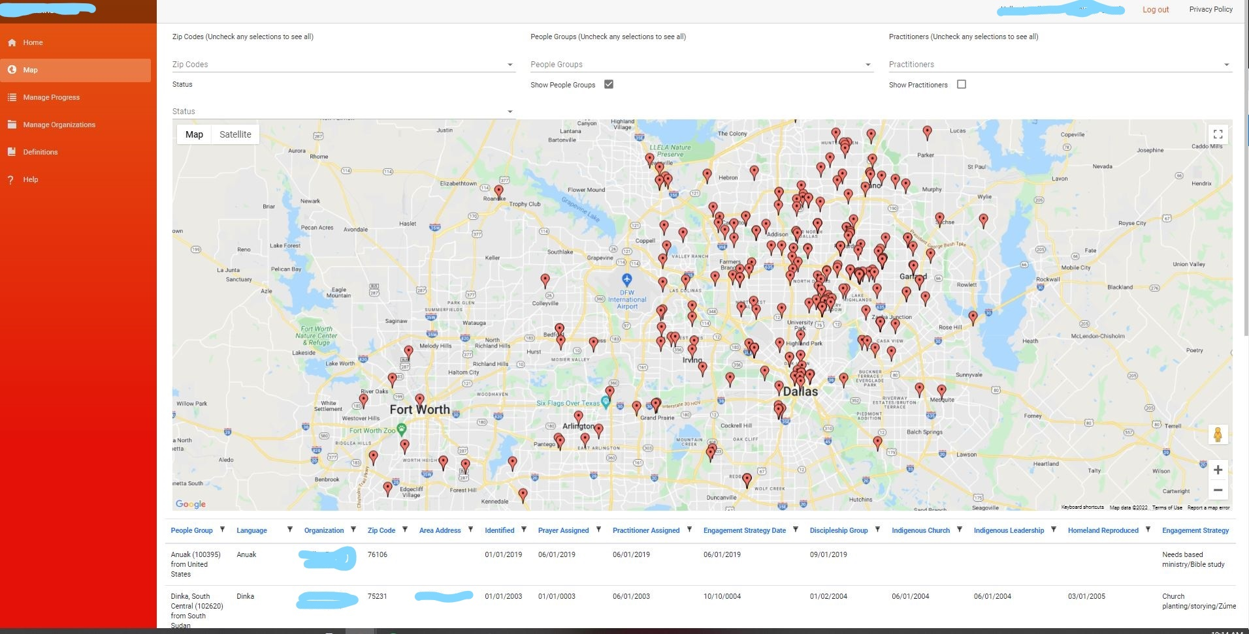
DFW Diaspora Coalition

Slide 24
PGT Benefits
Real-time information
Minimizes duplication
Efficient engagement
Identifies gaps
Prayer support
Pilot testing with ministries

Slide 25
Ecosystem Design
Directory of opportunities
Tracking metro progress
Intra-member communication

Slide 26
Ecosystem Design
Directory of opportunities
Tracking metro progress
Intra-member communication
Training for engagement
Multiple avenues (philosophy, doctrine)
Basic missions to cross-cultural discipleship

Slide 27
Ecosystem Design
Directory of opportunities
Tracking metro progress
Intra-member communication
Training for engagement
Involving all ethnicities
Whole Church (Black/Hispanic/Asian, Diaspora)
More workers AND witness to diaspora (history)
Changing communities (need trusted help)

Slide 28
Ecosystem Design
Directory of opportunities
Tracking metro progress
Intra-member communication
Training for engagement
Involving all ethnicities
Field to Force

Slide 29
Ecosystem Design
From Mission Field to Mission Force
Bible training in 25 Texas prisons
Source of cross-cultural workers
Source of energy and boldness
3-step deployment (inside, re-entry, placement)

Slide 30
Participation
Required
Shared understanding “Who We Are”
Join Slack for internal communication
Voluntary
Participation on website
Participation with PGT
Periodic in-person meetings

Slide 31
Retain Existing Networks (examples)
Specialty networks (ISM)
Ministry philosophy networks (DMM)
DFW Diaspora Coalition
Denominational
networks
(Baptist)
Mobilization
Networks (DFW Mobilizers)

Slide 32
Tools vs. Collaboration
“You can build it, we can help”
We will create the tools to begin
You do the collaboration

Slide 33
Milestones
Launch website (Alliance 436)
Pilot test People Group Tracker (Tim Ahlen)
Launch Slack platform (Alliance 436)
Develop a list of objectives for 2024-25 (Don Allsman)
Fall info meeting at DTS (Bill Hendricks)

