Slide 1
Completion Global
Innovation for the Great Commission
Don Allsman, CEO (don.allsman@completion.global)
www.completion.global
Slides available at completion.global/tools for ministry

Slide 2
Urban Shift:
Launching an Urban Collaborative Ecosystem
Introductions: name, ministry, where you live

Slide 3
Completion Global
Innovation for the Great Commission
Two passions: ta ethne and everyone involved
Inspire Church to world missions (diaspora)
Empower the under-represented (field to force)
Create crowdsourcing tools (full participation)

Slide 4
Urban Shift:
Launching an Urban Collaborative Ecosystem
Cities encapsulate the challenges of our rapidly shifting world. How creating a network or “collaborative ecosystem” in urban centers can empower ministries, foster partnerships, and lead to more effective, innovative outreach around the challenge of diaspora and unreached peoples.

Slide 5
Eldon Porter
Linking Global Voices

Slide 6
Case studies:
Networked, Urban, Diaspora Ecosystems
Why an ecosystem?
What does an ecosystem look like?
Q&A
Lessons learned
Steps to launch ecosystem in your city

Slide 7
Why: The Opportunity is Great
UPG* America (Diaspora)
Professionals
Immigrants
Refugees
Students
Videostreaming, cell phone discipleship and church planting
Friends/family (oikos)
Asia
Africa
Latin America
Europe
Visit near-culture uupgs*
*UPG unreached people group with so few Christian leaders they still need missionary support
*UUPG unengaged-unreached people group having no known full-time workers attempting discipleship or church planting

Slide 8
Why: The Challenges are Significant
Complexity of urban setting
Lack of bandwidth to collaborate
Lack of accessible technology tools
Lack of visibility: overlap/gaps in engagement
Latent workers unaware of opportunities

Slide 9
Solution: Ecosystem
Organisms interact to form life
No central leadership
Each does its part for the whole
Metro-wide (church, parachurch, agency)

Slide 10
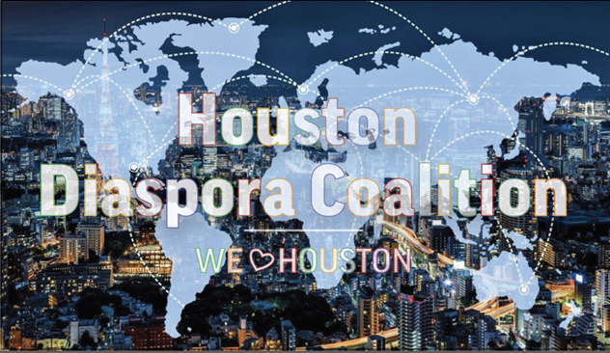
houstondiasporacoalition.net
dfw.diasporacoalition.net

Slide 11
https://vimeo.com/840118669?share=copy

Slide 12
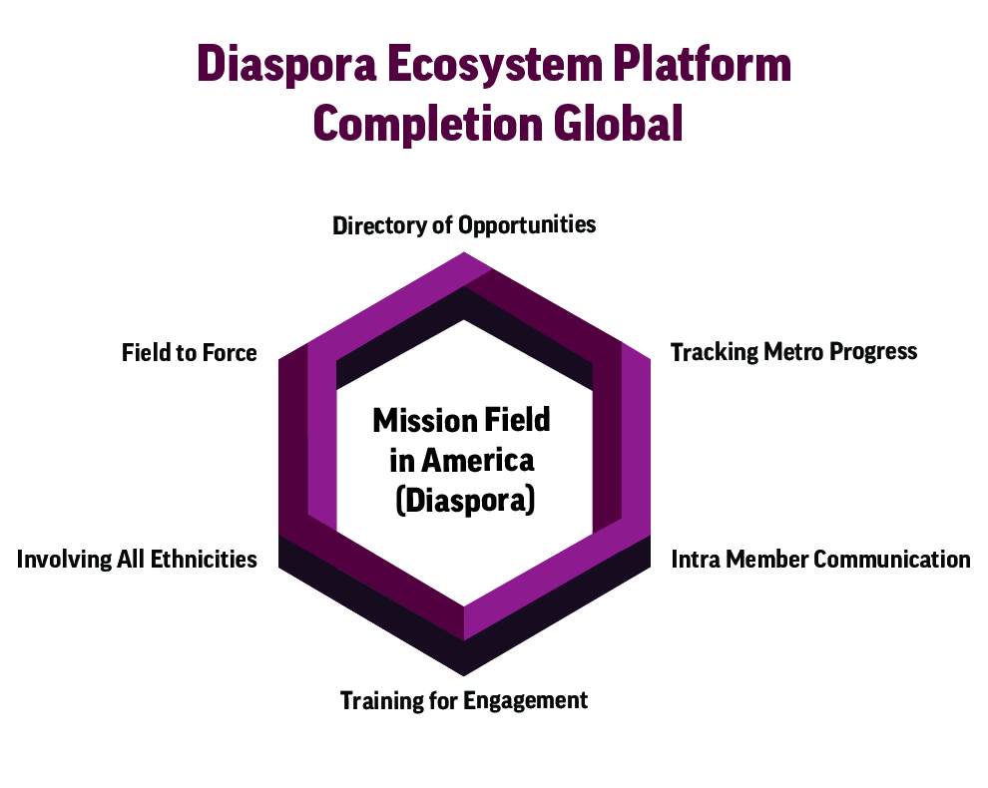
DFW Diaspora Coalition Ecosystem

Slide 13
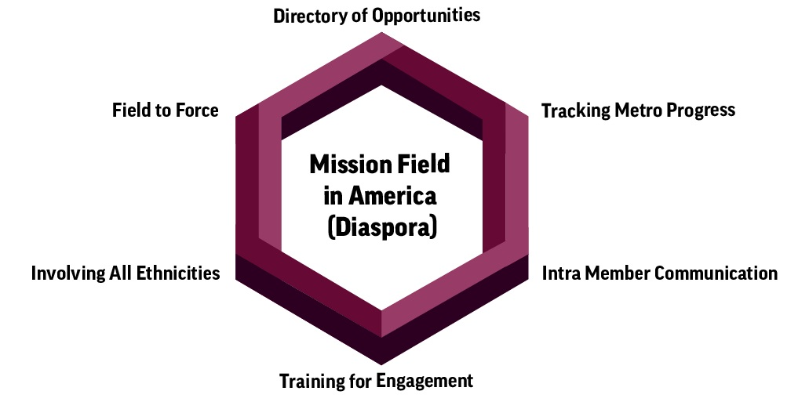
Ecosystem Design
Directory of opportunities

Slide 15
Options for Involvement
SUPPORTING DIASPORA WORKERS
Prayer
Research
Networking & Fellowship
Administration & Technology
Support Raising & Funding
Preparing the Incarcerated for Diaspora Ministry
EXPLORING DIASPORA MISSION
World Missions
Understanding Islam
Understanding Buddhism
Understanding Hinduism
Understanding Other Faith Backgrounds
Discipleship & Church Planting
STRENGTHENING DIASPORA CHURCHES
Resourcing
Sharing Property, Facility or Equipment
Specialized Support
Reaching Other Diaspora Groups
Bible and Ministry Training
ENGAGING DIASPORA NEIGHBORS
English as a Second Language
International Students
Refugee Ministry
Children
Neighbors & Co-Workers
Justice & Advocacy
Holistic Health & Wellness
Evangelism & Disciple-Making
Coaching & Internships

Slide 16
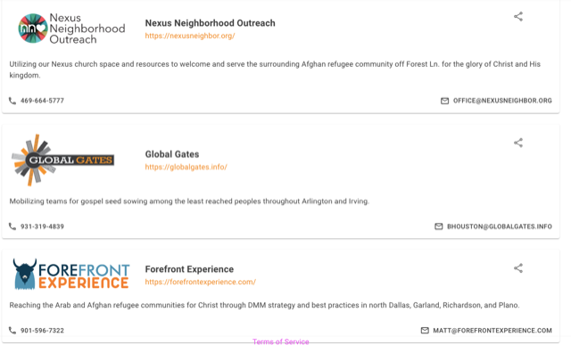

Slide 17
Ecosystem Design
Directory of opportunities
Tracking metro progress

Slide 18
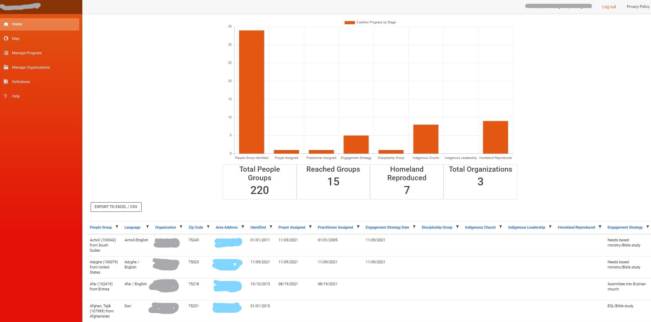
People Group Tracker

Slide 19
Milestones
PG Identified
Prayer assigned
Practitioner assigned
Engagement strategy
Discipleship group
Indigenous church
Indigenous leadership
Homeland reproduced

Slide 20
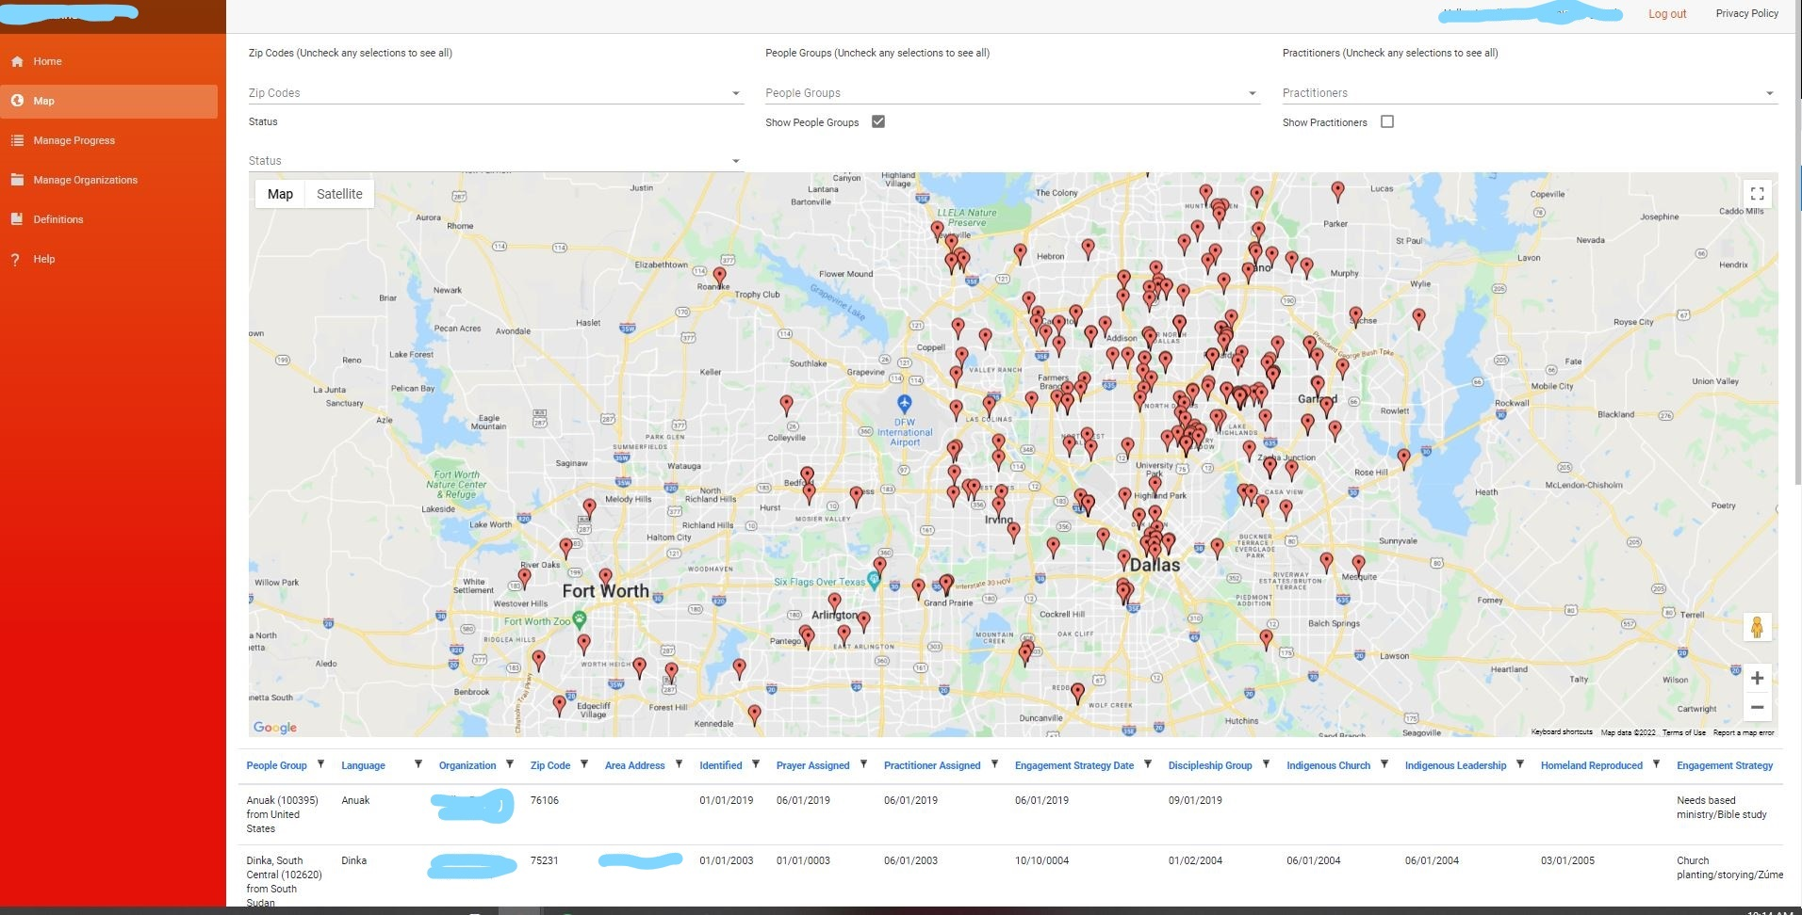
DFW Diaspora Coalition

Slide 21
PGT Collaboration Benefits
Real-time information
Minimizes duplication
Efficient engagement
Identifies gaps
Prayer support

Slide 22
Q&A for Eldon and Don

Slide 23
DFW Diaspora Coalition Ecosystem

Slide 24
Ecosystem Design
Directory of opportunities
Tracking metro progress
Intra-member communication

Slide 25
Ecosystem Design
Directory of opportunities
Tracking metro progress
Intra-member communication
Training for engagement
Multiple avenues (philosophy, doctrine)
Basic missions to cross-cultural discipleship

Slide 26
Ecosystem Design
Directory of opportunities
Tracking metro progress
Intra-member communication
Training for engagement
Involving all ethnicities
Whole Church (Black/Hispanic/Asian, Diaspora)
More workers AND witness to diaspora (history)
Changing communities (need trusted help)

Slide 27
Ecosystem Design
Directory of opportunities
Tracking metro progress
Intra-member communication
Training for engagement
Involving all ethnicities:
Reconcilation Fellowship

Slide 28
Ecosystem Design
Directory of opportunities
Tracking metro progress
Intra-member communication
Training for engagement
Involving all ethnicities
Field to Force

Slide 29
Ecosystem Design
From Mission Field to Mission Force
Bible training in 25 Texas prisons
Source of cross-cultural workers
Source of energy and boldness
3-step deployment (inside, re-entry, placement)

Slide 30
Lessons Learned
Retention of organizational identity (connect silos)
Minimum commitments (time/money)
Serve the church (agencies leading)
Sharing the load (reduce a full plates)
Honor other networks

Slide 31
Honor Existing Networks
Specialty networks (ISM)
Ministry philosophy networks (DMM)
DFW Diaspora Coalition
Denominational
networks
(Baptist)
Mobilization
Networks (DFW Mobilizers)

Slide 32
Lessons Learned
Retention of organizational identity (connect silos)
Minimum commitments (time/money)
Serve the church (agencies leading)
Sharing the load (reduce a full plates)
Honor other networks
Offer tools but let collaboration be organic

Slide 33
Tools vs. Collaboration
“You can build it, we can help”
We will create the tools to begin
You do the collaboration

Slide 34
Steps to Launch
At least three people committed to launch
Agree on mission, vision, values

Slide 35
DFW Diaspora Coalition
Mission
Convene a local, organic network of people offering holistic ministry, evangelism, discipleship, church planting, and church leadership development for DFW’s diaspora people groups until such time that there are no remaining unengaged-unreached people groups on the earth.

Slide 36
DFW Diaspora Coalition
Initial Vision
Develop a city-wide strategy to establish indigenously-led churches among every UPG in DFW until each one plants a church among its homeland people.

Slide 37
DFW Diaspora Coalition
Values
Build on local history
Every-believer participation
Deference to culture
Reaching the world
Honoring member distinctives

Slide 38
DFW Diaspora Coalition
Phases
Develop ecosystem and invite others as peers
UPGs reproduce in the homeland
Move to indigeneity (diaspora take ownership)

Slide 39
Steps to Launch
At least three people committed to launch
Agree on mission, vision, values
Person overseeing website, tracking, IM platform
Invite people to informational meetings
Launch IM platform (Slack)
Populate directory website
Pilot test tracking (PGT)
Keep inviting people (ethnicity, field to force)
Offer resources to pastors
Develop and execute annual objectives

Slide 40
Costs
Website directory: free if hosted locally
People group tracker: free if hosted locally
Slack platform: free version available
If tech support is desired: $XX/month

Slide 41
Completion Global
Innovation for the Great Commission
Don Allsman, CEO (don.allsman@completion.global)
www.completion.global

